Slide 1
User guide:
How to use IPR un-normalized patents update feature
For: the users
17/08/2023

Slide 2

Content
Create un-normalized patent update session for an ISLD: 3
Consult un-normalized patent update session for an ISLD: 7
Normalize a patent: 8
Undo patent normalization: 12
Abandon / undo abandonment of an un-normalized patent: 14
Preview document during update session edition: 16
Finalize an un-normalized patent update session: 18:
    Using integrated Adobe Sign solution: 21
    Using another e-signature tool: 25
Discard an un-normalized patent update session: 30
View signatures disclaimer on ISLD declaration page after successful publication of un-normalized patent update session: 34
Update reflected ISLD when ‘Updated Reflected Declaration’ document is signed: slides 36
Un-normalized patent filing date: 39
E-mail Notifications: 42

Slide 3
Create un-normalized patent update session for an ISLD
Each reflected ISLD with un-normalized patents ​(in its disclosures be it as basis patents or family members) can be modified by authorized users(*) to modify these patents (i.e., either normalize them, abandon them or leave them as they are). To be able to modify a declaration's un-normalized patents, the notion of an ‘un-normalized patent update session’ is introduced.
An ‘un-normalized patent update session’ can be in only one of the following statuses:
    In progress
    Pending signature
    Expired
    Discarded
    Published
  To have an ‘un-normalized patent update session’ on a declaration: the logged-in user must be authorized to do it, the declaration must be of type ISLD, in status ‘Reflected’, and must not currently have any session in status ‘in progress’ or ‘pending signature’.
  Only one session in status ‘in progress’ or ‘pending signature’ is allowed per Reflected ISLD declaration at a time.

Slide 4
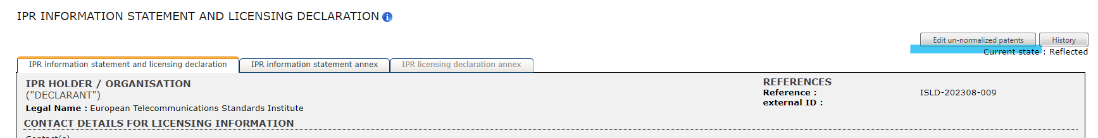
Create un-normalized patent update session for an ISLD
Authorized users:
    a user who created the ISLD declaration
    a user with the role of ‘authorized editor’ (EDI) for that specific ISLD declaration's declarant company
The functionality is accessible upon displaying an eligible ISLD's page:
    Access ipr.etsi.org
    Search for the Reflected ISLD declaration
    Access the Reflected ISLD declaration in ‘read-only’ mode (via the ‘view’ option)
  A button ‘Edit un-normalized patents’ is displayed on the top right corner of the reflected ISLD page:

Slide 5
Create un-normalized patent update session for an ISLD
  Click on the "Edit un-normalized patents" button:
    Session page is created and loaded successfully
    ‘UN-NORMALIZED PATENT UPDATE SESSION FOR IPR INFORMATION STATEMENT AND LICENSING DECLARATION’ title is displayed on top of the page
    An information message, containing a detailed set of instructions, is visible to the user, under the page title
  The global layout of the un-normalized patent update session page resembles the layout of the ISLD declaration page. Only one tab is displayed. This tab is active/opened by default. No other tab can be selected.
  Only the disclosures which are eligible for updates (i.e., that contain at least one 'basis' or 'family member' patent that is currently un-normalized) are displayed. All the displayed disclosures' ‘ETSI Projects’ and ‘Work Item or Standard’ sections are shown in read-only mode.
  If the patent is un-normalized, it is shown in ‘editable’ mode:
    The edit of an un-normalized patent is optional, however, to edit an un-normalized patent:
      The user cannot remove it.
      The user cannot replace it with another un-normalized patent.

Slide 6
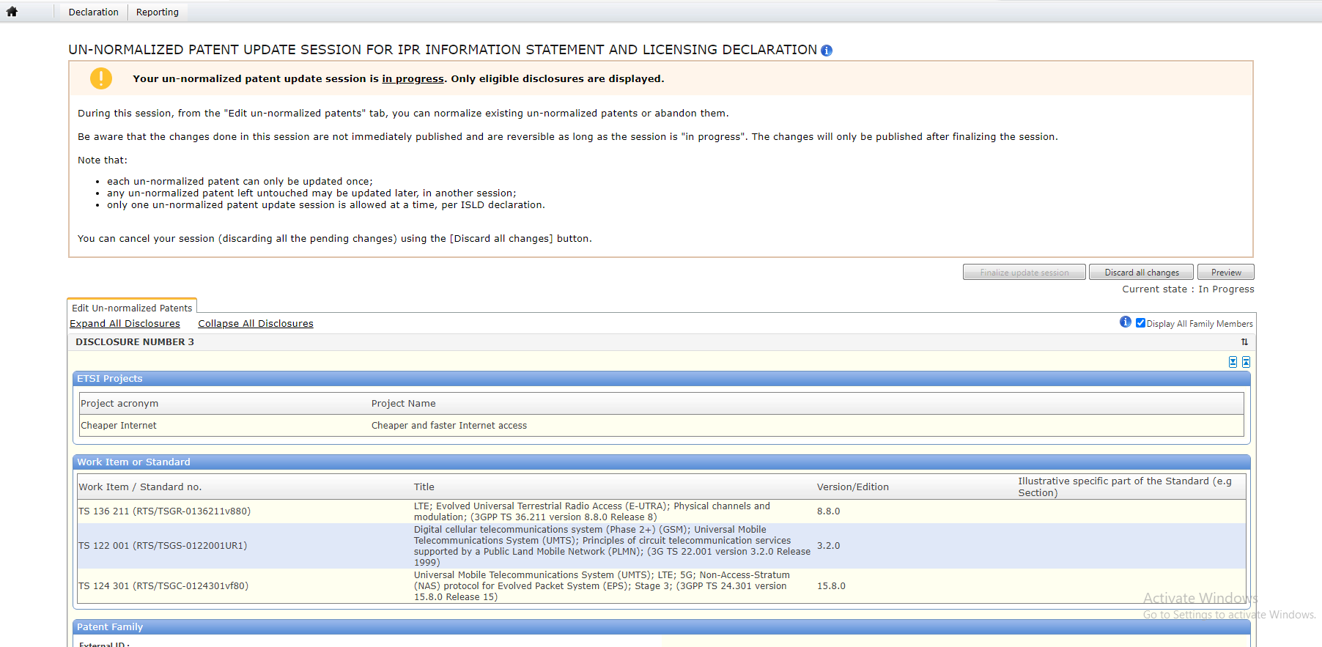
Create un-normalized patent update session for an ISLD

Slide 7
Consult un-normalized patent update session for an ISLD
Specific users are allowed to consult update sessions from the respective ISLD declaration pages:
The un-normalized patent update session OWNER (the user who created the update session) can consult the update session when it is in status:
    in progress
    pending signature
Any other authorized user (different from the person who created the update session) who has either created the ISLD or who has EDI permission for that declaration's declarant company can consult the update session when it is in status:
    in progress
    pending signature
The database managers (i.e., users with ADM/MGN permission) can consult any update session when it is in status:
    in progress
    pending signature

Slide 8
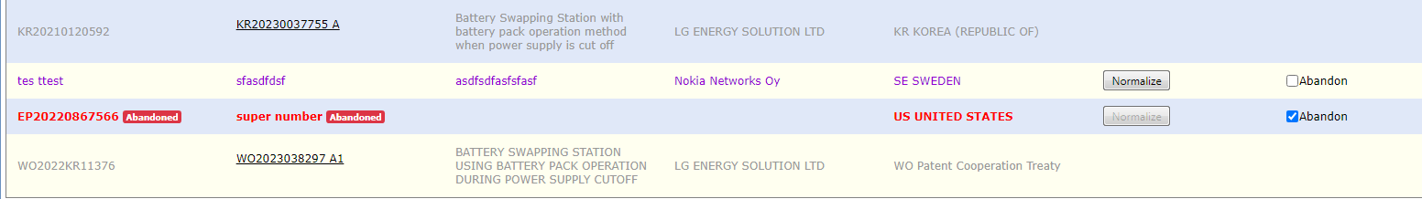
Normalize a patent
The functionality is accessible upon displaying an eligible ISLD's page:
    Access ipr.etsi.org
    Search for the Reflected ISLD declaration
    Access the Reflected ISLD declaration in ‘read-only’ mode (via the ‘view’ option)
    Click on the ‘Edit un-normalized patents’ button:
    For each eligible patent, an action button ‘Normalize’ is displayed, in a 'column' labelled as ‘Un-normalized patent update’. The ‘Normalize’ button is only enabled when the ‘Abandon’ checkbox is unchecked. It is disabled & greyed-out otherwise:

Slide 9
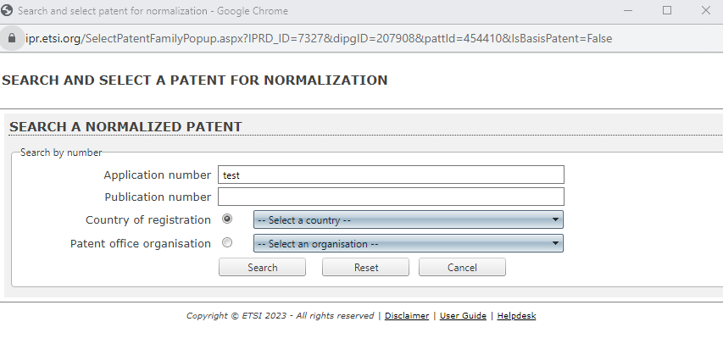
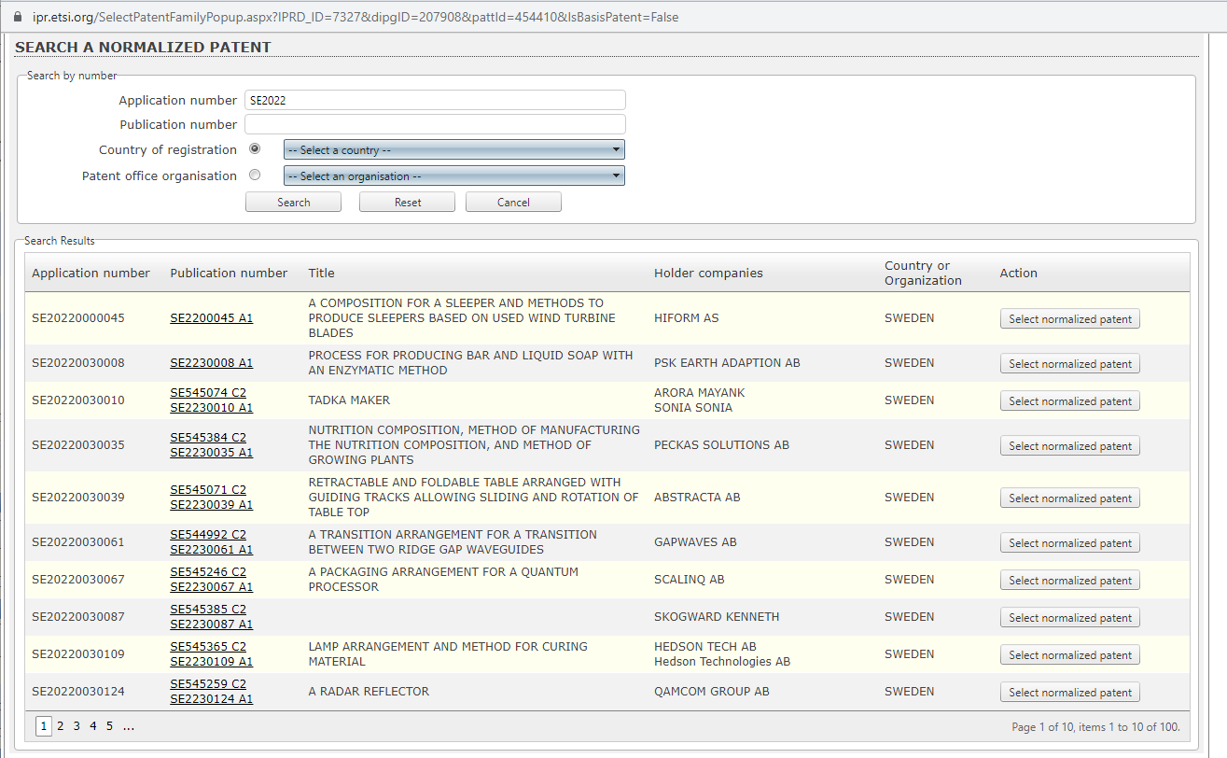
Normalize a patent
Click on the ‘Normalize’ button, a ‘normalization’ pop-up opens and search for a normalized patent:
Once search criteria section is complete, click on search button. The search is done in EPO. The ‘Search results’ section appears:

Slide 10
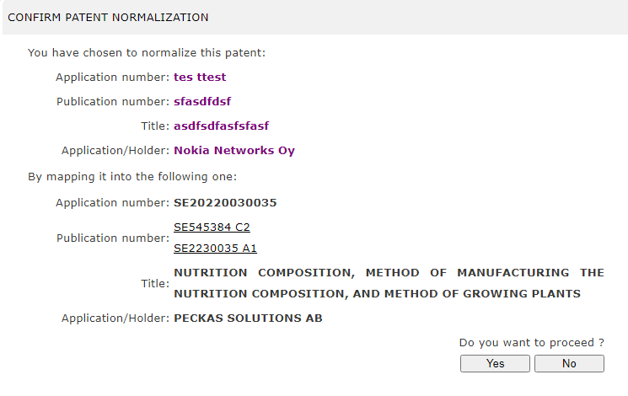
Normalize a patent
Click on ‘Select normalized patent’ button, the normalization confirmation pop-up appears, mapping the un-normalized data into normalized with 2 action buttons:

Slide 11
Normalize a patent
If clicked ‘No’:
    The normalization confirmation pop-up closes immediately
    No data modifications are done in the session
    The ‘Search and select patent for normalization’ pop-up is still shown/active
    The search results are still visible
    The user is allowed to use the button "Select normalized patent" for any patent listed in the search results
If clicked ‘Yes’:
    The normalization confirmation pop-up closes
    The ‘Search and select patent for normalization’ pop-up closes
    The patent that has been "normalized" is now displayed as ‘formerly un-normalized’ in the session page. i.e., each patent field that had a value when before the normalization is now followed by a special icon. This icon is displayed on the right-hand side of each ‘replaced’ patent field. When the user moves the mouse over the icon, the original un-normalized data is displayed. This icon is displayed on each value that were not empty and has been replaced during the normalization
    The patent is no longer displayed in purple
    The button ‘Normalize’ becomes disabled/greyed-out but is still visible
    A new button ‘Undo’ appears, on the right side of ‘Normalize’. It is enabled:

Slide 12
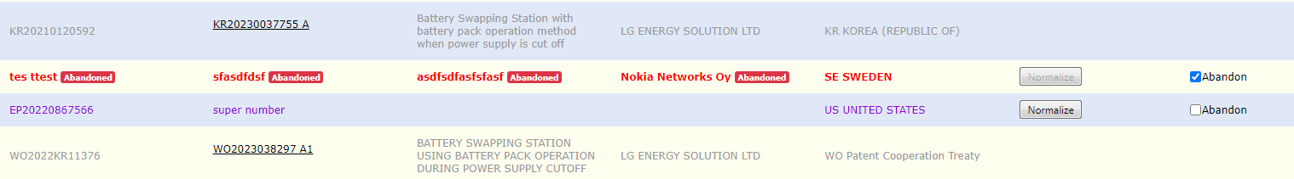
Undo patent normalization
The ‘Undo’ action refers to the normalization of an un-normalized patent.
This action is only available during update sessions ‘in progress’ and for un-normalized patents which are currently marked as ‘normalized’ during the session.
An ‘Undo’ button is displayed for each patent currently marked as normalized due to an un-normalized patent update done during the ‘in progress’ session.
‘Undo’ button is hidden and disabled:
    By default.
    If the un-normalized patent is currently flagged as ‘Abandoned’ in the session.
    If the un-normalized patent is not currently marked as normalized in the session:

Slide 13
Undo patent normalization
The ‘Undo’ button is visible and enabled only if the un-normalized patent is currently normalized in the session.
Upon clicking ‘Undo’ button:
    The normalization that was previously done in the session is immediately undone
    The un-normalized patent display is instantly refreshed: it is displayed in its original form - in purple and with the original values only
    No EPO patent number is mapped anymore to the respective un-normalized patent
    The ‘Undo’ button becomes hidden and disabled
    The ‘Normalize’ button becomes enabled
    The ‘Abandon’ checkbox remains visible/usable:

Slide 14
Abandon / undo abandonment of an un-normalized patent
Any un-normalized patent that is editable via the un-normalized patent update session 'in progress' can be flagged as 'abandoned’.
A checkbox 'Abandon':
    Is visible for each eligible patent
    Is visible even if an un-normalized patent has already been normalized in the current update session
    Is unchecked by default:
    When it is checked/ticked:
    It appears as checked/ticked
    The respective un-normalized patent data are immediately displayed in red instead of purple
    The respective patent number fields (‘Application Number' & ‘Publication Number’) values are appended by a red label ‘Abandoned’
    The ‘Normalize’ button becomes disabled/greyed-out (but still visible)
    The normalization ‘Undo’ button is disabled and hidden
    The ‘Abandon’ checkbox remains visible/usable:

Slide 15
Abandon / undo abandonment of an un-normalized patent
    When it is unchecked/unticked:
    The patent information display is refreshed instantly: the un-normalized patent is no longer marked as ‘Abandoned’ or shown in red. Instead, it is fully displayed in ‘purple’ colour and without any label (i.e., un-normalized patent representation)
    The respective abandonment flag removal is automatically saved in the temporary DB, for the respective patent
    The ‘Normalize’ button becomes enabled/usable
    The normalization "Undo" button remains disabled and hidden
    The "Abandon" checkbox remains visible/usable:

Slide 16

Preview document during update session edition
Authorized user:
un-normalized patent update session owner (i.e., the user who created/started the respective un-normalized patent update session and is therefore allowed to edit and manage it).
The un-normalized patent update session is in status ‘in progress’.
The functionality is accessible upon displaying an eligible ISLD's page:
    Access ipr.etsi.org
    Search for the Reflected ISLD declaration
    Access the Reflected ISLD declaration in ‘read-only’ mode (via the ‘view’ option)
    Click on the ‘Edit un-normalized patents’ button:
A ‘Preview’ action button is displayed on the right-hand top corner of the un-normalized patent update session page. When clicked:
    A pop-up appears, displaying the final version of the ISLD, in preview mode, via a PDF viewer
    This preview is printable/downloadable by the user
    The preview document type is portable document format (PDF)
    This preview considers all the modifications made in the update session
    This preview file is generated in real-time upon hitting the button

Slide 17
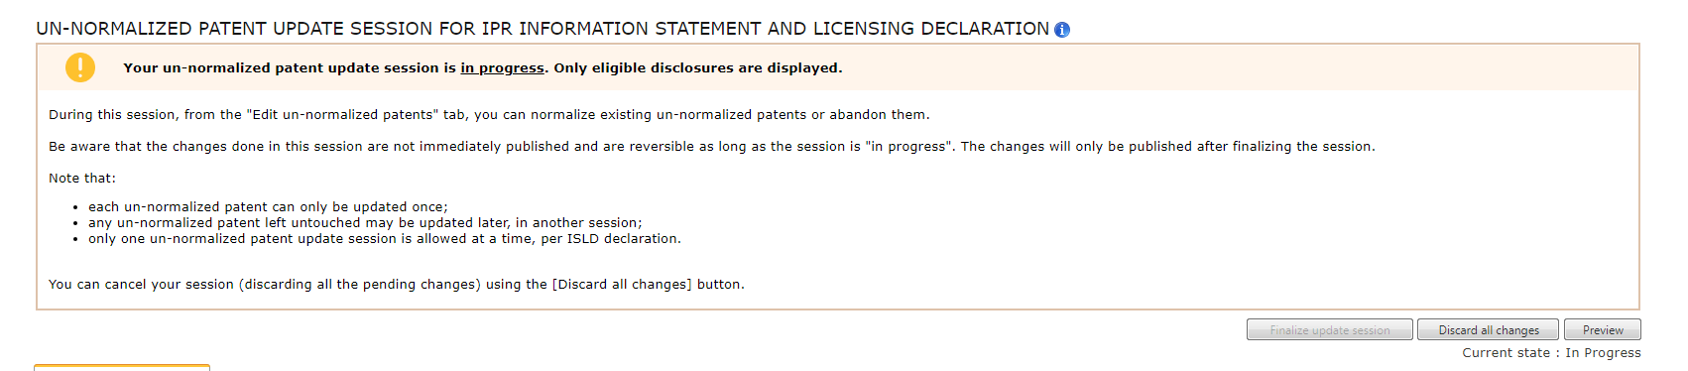
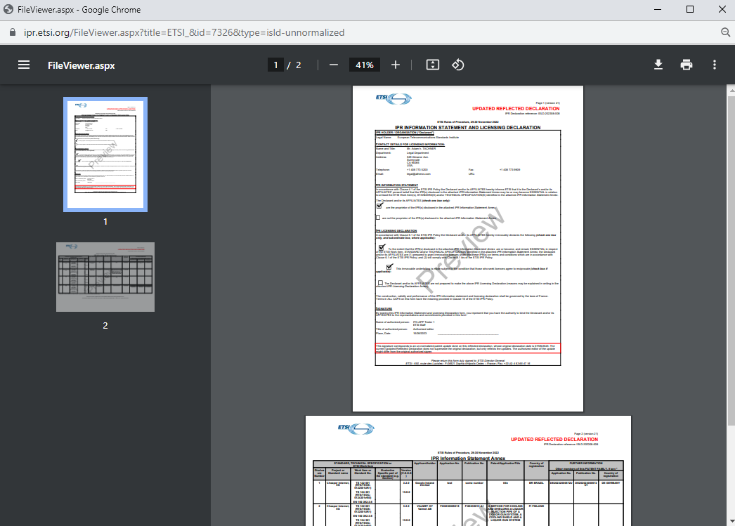
Preview document during update session edition

Slide 18
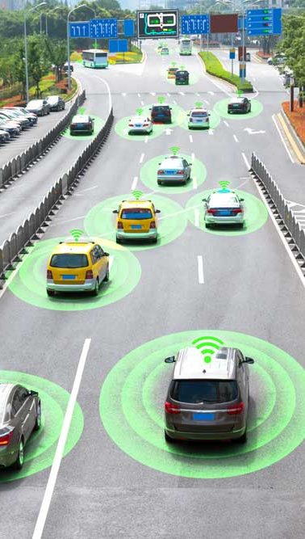
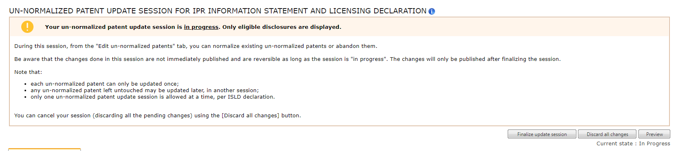
Finalize an un-normalized patent update session
Authorized user: un-normalized patent update session OWNER.
The un-normalized patent update session is in status ‘in progress’, and at least one un-normalized patent has been updated (i.e., either normalized or abandoned).
The functionality is accessible upon displaying an eligible ISLD's page:
    Access ipr.etsi.org
    Search for the Reflected ISLD declaration
    Access the Reflected ISLD declaration in ‘read-only’ mode (via the ‘view’ option)
    Click on the ‘Edit un-normalized patents’ button to access the un-normalized patent update session page
    An action button ‘Finalize update session’ is displayed in the un-normalized patent update session page. It is enabled when there is at least one normalized or abandoned change made in the session update. Otherwise, it is disabled:

Slide 19
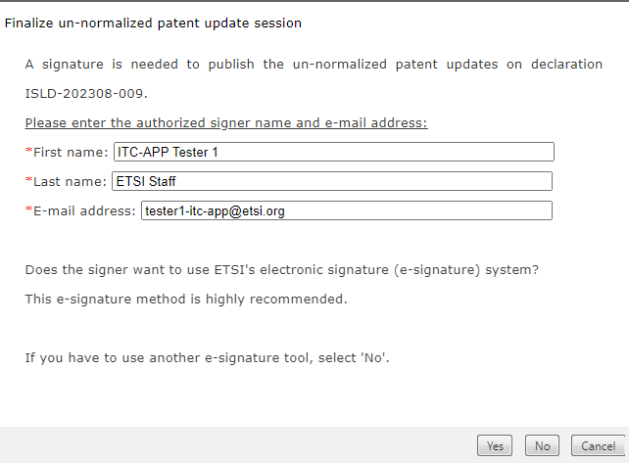
Finalize an un-normalized patent update session
    When clicked on ‘Finalize update session’ button, a first pop-up opens, to request which signature method the user would like to choose.
    Three action buttons are available: ‘Yes’, ‘No’, and ‘Cancel’. All of them are enabled by default, provided all three input fields (First name, Last name, E-mail address) are filled in.
    If at least one of the three input fields (First name, Last name, E-mail address) is empty or contains invalid text/formatting: The button ‘Yes’ and ‘No’ are automatically disabled/greyed-out.
    Only one button can be selected:

Slide 20

Finalize an un-normalized patent update session
Upon clicking ‘Cancel’:
    The pop-up closes
    The status of the update session remains ‘in progress’
    No modifications are done whatsoever in the database
    The page does not reload/refresh when the pop-up closes
    The action button ‘Finalize update session’ continues visible/enabled:

Slide 21
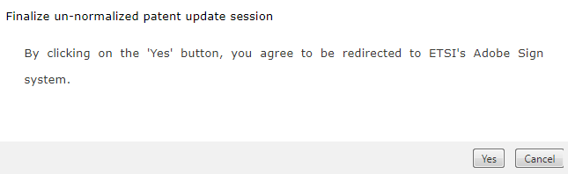
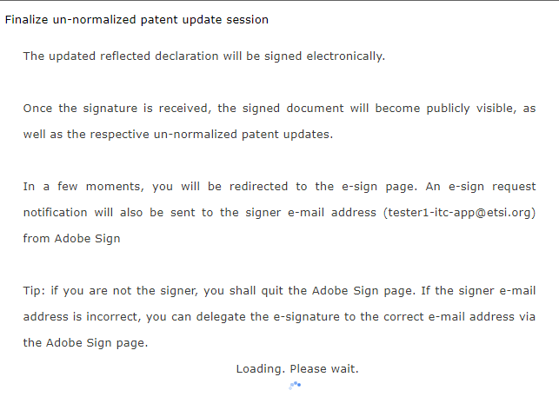
Finalize an un-normalized patent update session - integrated Adobe Sign solution
    Upon clicking ‘Yes’, a second confirmation pop-up is displayed, for the user to confirm to be redirected to Adobe Sign. Two answer buttons are available: ‘Yes’ and ‘Cancel’. Both are enabled. Only one can be selected:
Upon clicking ‘Yes’:
The pop-up content changes and a loading icon, and a loading message, are shown:
Tip: if you are not the signer, you shall quit the Adobe Sign page.
If the signer e-mail address is incorrect, you can delegate the e-signature
to the correct e-mail address via the Adobe Sign page.

Slide 22
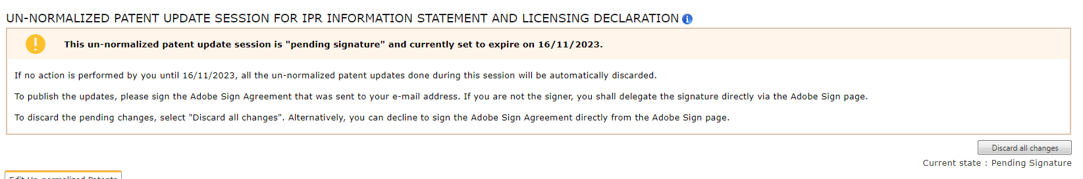
Finalize an un-normalized patent update session - integrated Adobe Sign solution
    The respective ‘Updated Reflected Declaration’ document is generated, with the name of the authorized signer in the first page and containing the whole data of the respective ISLD declaration and including the un-normalized patent update changes that were done in the session
    An Adobe Sign Agreement is created, and set to status ‘DRAFT’, to send the generated ‘Updated Reflected Declaration’ document for signature (to the inputted authorized signer email address)
    The pop-up is closed and the Adobe Sign signing URL page opens in a new window
    The status of the update session becomes ‘Pending signature’
    An e-mail notification is sent.
    The page is reloaded, and the update session page becomes visible in read-only mode. The status, buttons, and message shown on the session page are all refreshed (see other stories for more details).
    The ‘Discard all changes’ button remains visible.
    The ‘Finalize update session’ and ‘Preview’ buttons are no longer visible:

Slide 23
Finalize an un-normalized patent update session - integrated Adobe Sign solution
    When the Adobe Sign Agreement is set to the ‘SIGNED’ status in Adobe Sign :
    The resulting e-signed document (downloaded directly from Adobe Sign) is automatically stored in the DARE DB and attached to the respective ISLD reflected declaration:
    The document type is ‘Updated Reflected Declaration’
    The document is publicly visible
    The document's filing date is set to the signature date retrieved from Adobe Sign for the respective Agreement
    The un-normalized patent update session status changes to the status ‘Published’
    ​If the Adobe Sign page was accessed directly from the session finalization page: when the Adobe Sign signing page is closed, the session page redirects the user to the ISLD declaration page. (Reason for redirect: ‘Published’ session pages are not visible)

Slide 24
Finalize an un-normalized patent update session - integrated Adobe Sign solution
    When the Adobe Sign Agreement is declined to sign (cancelled):
    The status of the Agreement is set to ‘CANCELLED’
    The un-normalized patent update session is set to the status ‘Discarded’
    ​If the Adobe Sign page was accessed directly from the session page: when the Adobe Sign signing page is closed, the session page redirects the user to the ISLD declaration page. (Reason for redirect: ‘Discarded’ session pages are not visible)
    Note: don't forget that users to whom you delegate the e-signature can also use the Adobe Sign feature ‘decline to sign’)

Slide 25
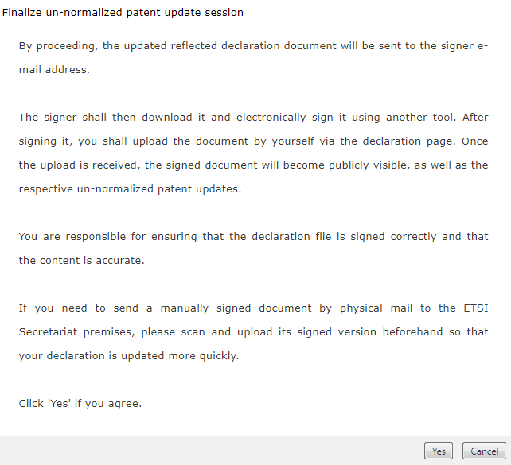
Finalize an un-normalized patent update session - using another e-signature tool
    When clicked on ‘Finalize update session’ button, a first pop-up opens, to request which signature method the user would like to choose.
    Upon clicking ‘No’, the 2nd pop-up appears:

Slide 26
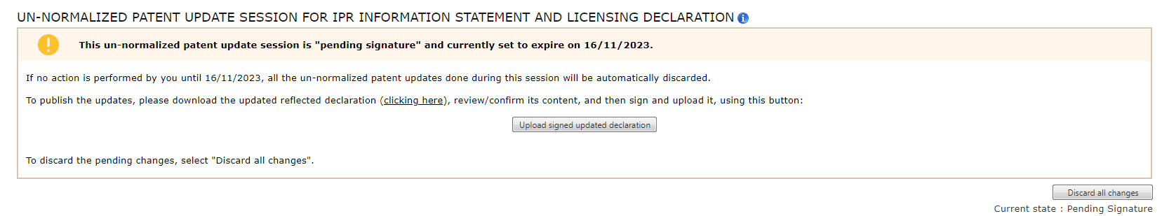
Finalize an un-normalized patent update session - using another e-signature tool
    Two buttons are visible: ‘Yes’ and ‘Cancel’. Both are enabled. Only one can be selected. If clicking ‘Yes’:
    An email notification is sent to the user (and to the signer e-mail address, if different) with instructions to sign the file another way (either with another e-sign tool, or manually) and the ‘Updated Reflected Declaration’ file is sent in attachment of that email
    The status of the update session becomes ‘Pending signature’
    The pop-up closes.
    The page is reloaded, and the update session page becomes visible in read-only mode. The status, buttons, and message shown on the session page are all refreshed (see other stories for more details).
    The ‘Discard all changes’ button remains visible.
    The ‘Finalize update session’ and ‘Preview’ buttons are no longer visible.
    The user can sign this PDF file with another e-sign tool of their choice or manually sign it (by pen and paper). After signing the file offline, the user shall be allowed to upload it from any of the two pages. A document download URL ‘clicking here’ or a file upload ‘Upload signed updated declaration’ button:

Slide 27
Finalize an un-normalized patent update session - using another e-signature tool
    Via document download URL 'clicking here':
    Always visible and enabled
    Upon clicking the hyperlink, the download of the ‘Updated Reflected Declaration’ file concerning the updates done during the session is triggered
    As soon as the URL is clicked, the file download could start immediately via the web browser
    The generated file is provided in portable document format (PDF)
    Via file upload ‘Upload signed updated declaration’ button:
    Enabled and visible by default
    Once clicked, the button opens a pop-up:

Slide 28
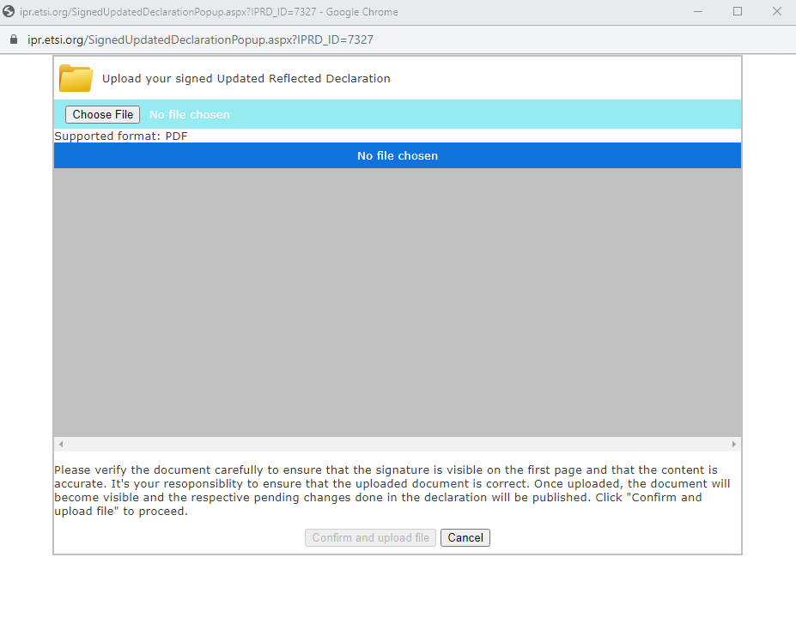
Finalize an un-normalized patent update session - using another e-signature tool
    Via document download URL 'clicking here':
    Always visible and enabled
    Upon clicking the hyperlink, the download of the ‘Updated Reflected Declaration’ file concerning the updates done during the session is triggered
    As soon as the URL is clicked, the file download could start immediately via the web browser
    The generated file is provided in portable document format (PDF)
    Via file upload ‘Upload signed updated declaration’ button:
    Enabled and visible by default.
    Once clicked, the button opens a pop-up:

Slide 29
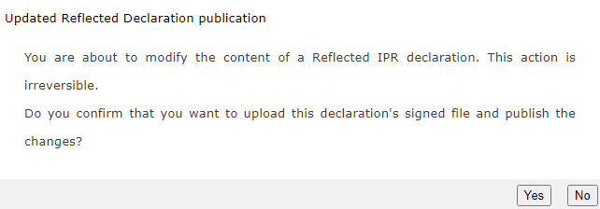
Finalize an un-normalized patent update session - using another e-signature tool
    The user can search through their machine file system, to find and select one PDF file to upload. The search is done on the PDF files only.
    The user has the options ‘Confirm and upload file’ or ‘Cancel’.
    If chosen ‘Cancel’, the pop-up closes, not making any modifications.
    If chosen ‘Confirm and upload file’, the following pop-up opens, indicating that this action will be irreversible:
    When chosen ‘Yes’, file is uploaded, attached to the respective ISLD declaration and becomes publicly visible (all users have access to it). The update session status changes to ‘Published’.

Slide 30

Discard an un-normalized patent update session
Authorized user: un-normalized patent update session OWNER (i.e., the logged-in user who started/created the respective un-normalized patent update session).
Un-normalized patent update session status is either 'in progress' or 'pending signature’:
    Access ipr.etsi.org
    Search for the reflected ISLD declaration to which the un-normalized patent update session refers
    Access the ISLD declaration in ‘read-only’ mode (via the ‘view’ option)
    From the ISLD declaration page, click on the respective button[*] to access the un-normalized patent update session page

Slide 31

Discard an un-normalized patent update session
If the current ISLD declaration's un-normalized patent update session is in the status:
'In progress’:
    Click on the ‘Edit un-normalized patents’ button from the ISLD declaration page to access the un-normalized patent update session page
    When the un-normalized patent update session page opens (in the same web browser tab):
      Three buttons are visible on the top right corner of the page:
      ‘Discard all change’: enabled by default
      ‘Finalize update session’: enabled by default
      ‘Preview’: enabled by default
      The status ‘In progress’ is visible on the upper right corner of the page, below the action buttons:

Slide 32
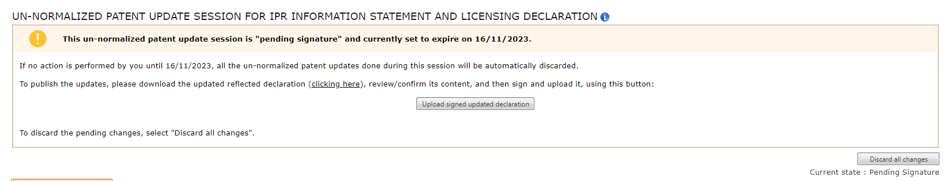
Discard an un-normalized patent update session
If the current ISLD declaration's un-normalized patent update session is in the status:
‘Pending signature’:
    Click on the ‘Sign and publish updates’ button from the ISLD declaration page to access the un-normalized patent update session
    When the un-normalized patent update session page opens (in the same web browser tab):
      One button is visible on the top right corner of the page:
      ‘Discard all changes’: enabled by default
      The status ‘Pending signature’ is visible on the upper right corner of the page, below the action buttons

Slide 33
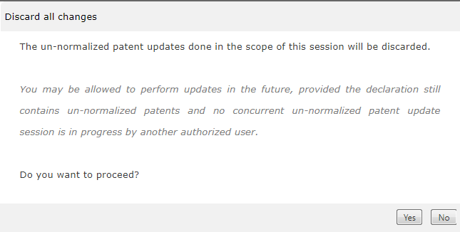
Discard an un-normalized patent update session
Upon clicking on the ‘Discard all changes’ button, a pop-up opens:
If clicked ‘No’:
    The pop-up is closed, and nothing happens
    No modifications are done
If clicked ‘Yes’:
    The page is loading, and all buttons become temporarily blocked
    The status of the un-normalized patent update session is set to ‘Discarded’
    If the update session was in the status ‘pending signature’:
      if the electronical signature (integrated Adobe Sign e-sign) had been selected, for the signature, then the related Adobe Sign agreement is cancelled
      otherwise, if manual signature had been selected, no specific actions are done
    The pop-up is closed.
    The user is redirected to the related reflected ISLD declaration page, in read-only mode. If the respective reflected ISLD declaration is still eligible for making un-normalized patent updates, then the button ‘Edit un-normalized patents’ is visible; no specific message is shown about update sessions (because the user has just discarded/cancelled it).

Slide 34
View signatures disclaimer on ISLD declaration page after successful publication of un-normalized patent update session
Public access.
When consulting an ISLD declaration in status ‘Reflected’ or ‘Not Reflected’, and when there is at least one ‘published’ un-normalized patent update session linked to that ISLD, then a disclaimer message is displayed to the user:
    Access ipr.etsi.org (logged in or not)
    Search for the respective reflected ISLD declaration
    Access the ISLD declaration in ‘read-only’ mode (via the ‘view’ option)
    By default, an ISLD declaration page opens in its first tab
    A new disclaimer message is shown, placed between 'Date:' (last field on the 'SIGNATURE' section) and the 'ATTACHED DOCUMENTS'
    It is displayed when there is at least one ‘published’ un-normalized patent update session related to the ISLD declaration:

Slide 35
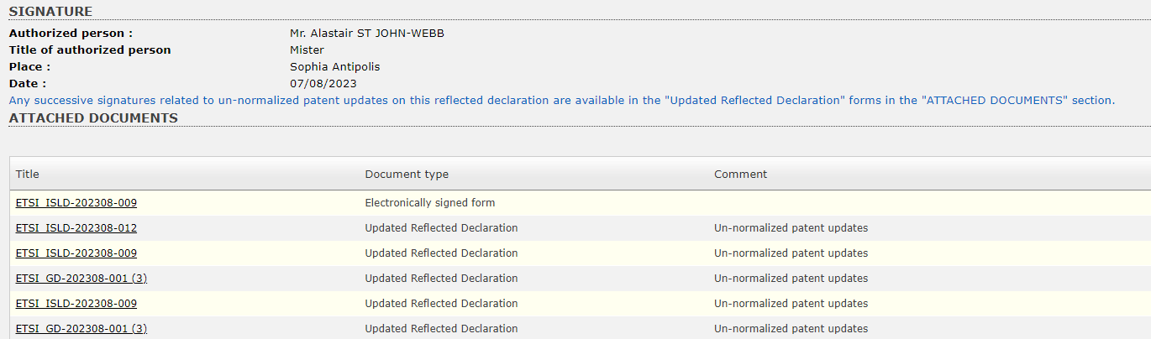
View signatures disclaimer on ISLD declaration page after successful publication of un-normalized patent update session

Slide 36
Update reflected ISLD when ‘Updated Reflected Declaration’ document is signed
A Reflected Information Statement and Licensing Declaration (ISLD) whose un-normalized patent update session becomes 'Published' is automatically updated, to include the respective changes done, as well as show a trace of the respective changes in form of History logs, messages in the declaration page, and specific attached documents.
Public access:
    Access ipr.etsi.org
    Search for the reflected ISLD declaration
    Access the ISLD declaration page in ‘read-only’ mode (via the ‘view’ option)
    Access the existing [History] page of an ISLD

Slide 37
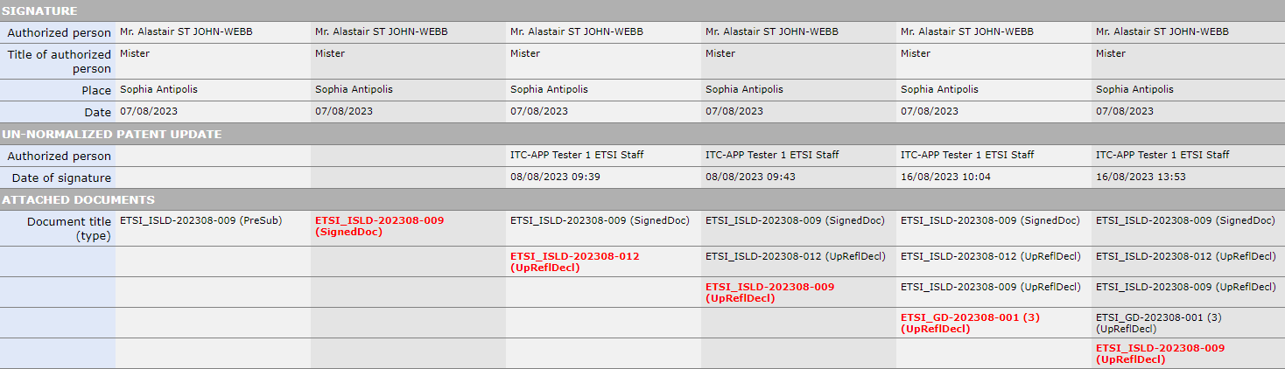
Update reflected ISLD when ‘Updated Reflected Declaration’ document is signed
1st tab of the history: A new section is displayed between ‘SIGNATURE’ and ‘ATTACHED DOCUMENTS’ of the history panel of the ISLD when there is at least one update session that has been published for that ISLD.
For each new un-normalized patent update session, a new history log (i.e., a new column) is added on the right-hand side of the history table:
    the ‘SIGNATURE’ section remains filled with the original authorized signer and date
    the ‘UN-NORMALIZED PATENT UPDATE’ section is filled in with :
      authorized person = authorized signer owner of the update session that has just been published
      date of signature: (= document filing date/time if it was manually signed; otherwise, Adobe Sign Agreement signing date/time)
      the ‘Justification’ line on the respective History log displays an automatic comment that was added upon session publication:

Slide 38
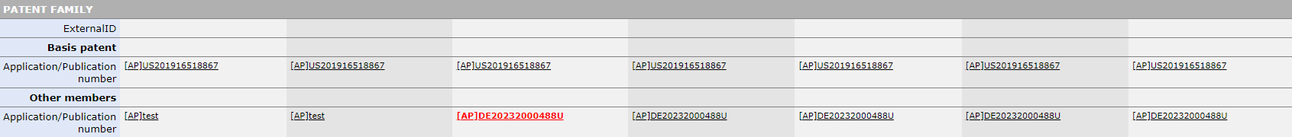
Update reflected ISLD when ‘Updated Reflected Declaration’ document is signed
2nd tab of the history: All the un-normalized patent updates (i.e., both normalizations and abandonment) are visible in the respective disclosures:
    For every disclosure that was updated, the respective modifications are visible
    Patents that became normalized are displayed with their normalized numbers only
    Patents that became abandoned are displayed with their original numbers, appended with ‘Abandoned’
    Note: there is a section for each DISCLOSURE
3rd tab of the history: no modifications can be visible due to un-normalized patent updates.

Slide 39
Un-normalized patent filing date
Every new un-normalized patent that gets created manually via the IPR database application (except for the un-normalized INDIAN patents which are created from Bulk Upload) must require the insertion of a filing date, consisting of day, month, and year (but without time information).
Authorized user:
Every logged-in user who has permission to edit ISLD declarations is authorized to create a new unpublished (un-normalized) patent.
Access:
In the existing pop-up ‘Select/create patent’ (which is accessible via the ‘Add’ option from an ISLD DISCLOSURE 'basis patent' or 'Other members'), a tab ‘Create/modify unpublished patent’ exists.
Note: the ‘Create/modify unpublished patent’ becomes enabled after a search has been done via the default (1st) tab, ‘Search Patents’, without returning any results.

Slide 40
Un-normalized patent filing date
A new field, ‘Filing date’, is visible on the un-normalized patents creation/modification pop-up tab.
The field is accompanied by an input field of type ‘date’:
    The user can write a date directly or use the calendar picker
    Dates inputted can be in the past or the current date. Dates in the future are not allowed
    A guidance text follows this input field "(dd/mm/yyyy)", always visible and displayed in dark grey on the right of the field
    The action buttons 'Create' / 'Update' are disabled/greyed out whenever the filing date field is empty
If the user is performing a 'Create':
    Once a new un-normalized patent is created, the inputted filing date is saved in the DARE database
If the user is performing an 'Update':
    Once a new un-normalized patent is updated, the inputted filing date is saved in the DARE database
Note: There is no information about the filing date for old un-normalized patents that already exist in the DARE DB. No ‘migration’ (data update) will be done.
Bulk Upload feature will remain untouched in the scope of this ‘un-normalized patent update tool’ project.

Slide 41
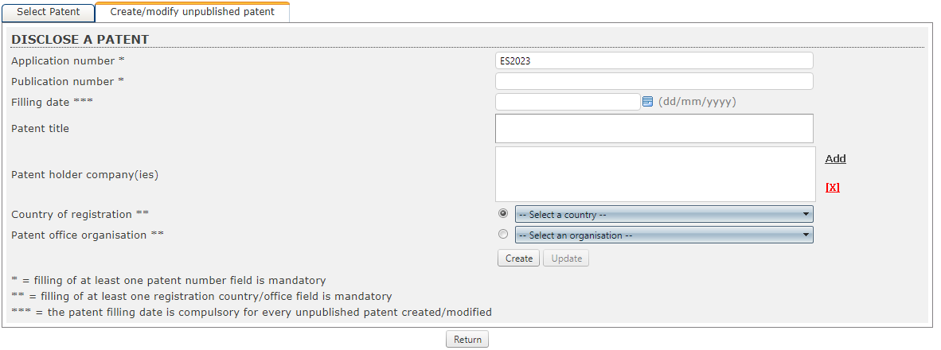
Un-normalized patent filing date

Slide 42
E-mail Notifications
In the scope of the un-normalized patent update project, several e-mail notifications are implemented.
The automatic e-mail notifications are sent:
    When an un-normalized patent update session is created
    When un-normalized patent update session is finalized (becomes pending signature)
    Notifies every week while an update session is still pending signature
    When an un-normalized patent update session is published
    When an un-normalized patent update session is discarded
    When un-normalized patent update session automatically expires
Note:
The email templates are managed/edited via the existing email template management feature (usable exclusively by the DB manager users).

Slide 43

Thank you for your attention
Follow us on:

Slide 44

Any further questions?
Contact us:
ipresign@etsi.org and helpdesk@etsi.org

